Slide 1
Overall Process
Design Thinking
Usability Engineering
Monolithic to microservices conversion
DevSecOps & AIOPS
Document as code
Scope n Deliver
Bug fix
Rolleback
Proactive Captureing of issues -- downtime

Slide 2



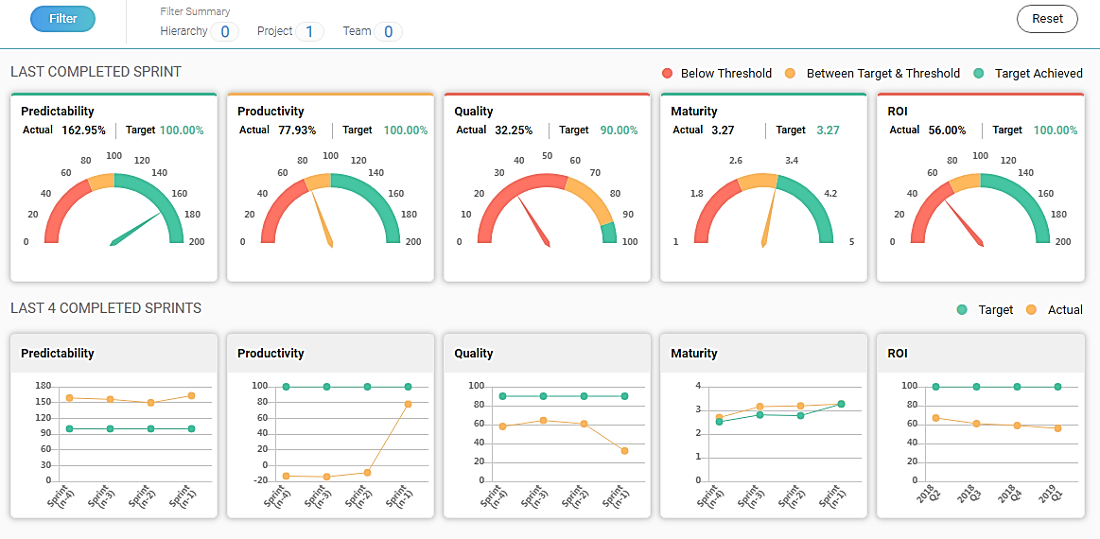
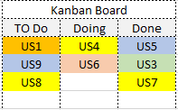
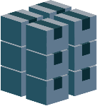
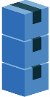
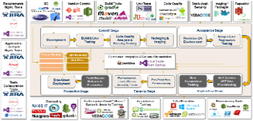
Hexaware’s Product Development Approach
Planning & Assessment
Design Experience
Platform and Product Development
Implementation & Launch
Product Sustenance
Systems of Engagement (omni-channel engagement) | Experience Design | Business process services (API, Microservices)ad
BFS Domain Expertise
Technology Accelerators
Integration (data/Services)|ALM/CLM
Niche Skills
1 – 4 Weeks Sprint
Scrum Master
Product Ideation
Business Idea to Epics
HexaView for Metrics tracking
Product Backlog
Sprint Backlog
UX Design / Prototypes
1 – 4 Weeks Sprint
User Insights
Go Live
L1/ L2 (Global)
MVP
Product development
L3 / L4
DevOps Automation
Insurance Domain Expertise
Technology Accelearor
Cloud Management (Infrastructure and Services)
Product Governance Framework and Agile Best Practices

Slide 3

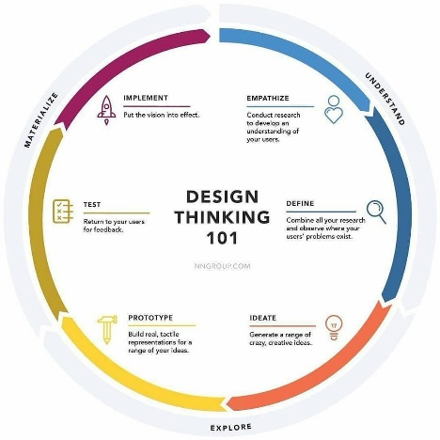
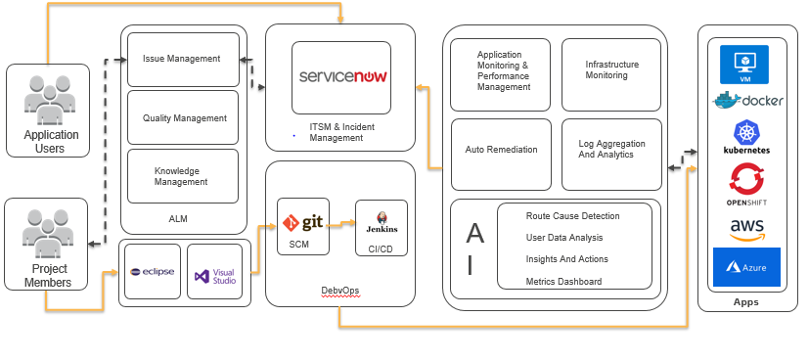
Development Approach
Ideation
UX Engineering
Feature/Services Development
Chaos Engineering
Implementation & Launch
omni-channel | Experience Design | Business process services (API, Microservices)
Technology Accelerators
Integration (data/Services)|ALM/CLM
Niche Skills
1 – 4 Weeks Sprint
Scrum Master
HexaView for Metrics tracking
Product Backlog
Sprint Backlog
UX Design / Prototypes
1 – 4 Weeks Sprint
User Insights
Go Live
L1/ L2 (Global)
MVP
Product development
L3 / L4
AIOps Automation

Slide 4
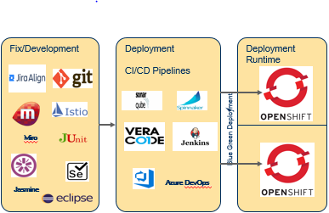
Development Approach
Product Management
& Planning
Development
Maintenance
Omni-channel | Experience Design | Business process services (API, Microservices)
Technology Accelerators(AppTrans)
User Insights
L1/ L2 (Global)
L3 / L4
AIOps Automation

Slide 5
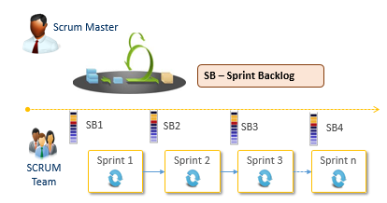




Development Approach
Product Management
& Planning
Development
Maintenance
Product
Backlog
Hex
Raise IT
ITSM & Incident Management
User Insights
JIRA
L1/ L2 (Global)
ALM
SCM
CI/CD
L3 / L4
AIOps Automation

Slide 6

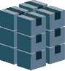
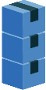

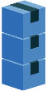
Niche Skills
1 – 4 Weeks Sprint
Scrum Master
Product Backlogw
Sprint Backlog
UX Design /
Prototypes
1 – 4 Weeks Sprint

Slide 7



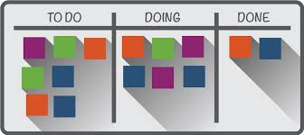



Execution Methodology – Scrum - TBU
The Release Plan and Sprint Length might change based on the priorities and dependencies outlined in Sprint 0.
The plan is to start Sprint 0, run 5 Sprints comprising of Development, Testing, UAT and E2E, and a final Sprint for Go Live.
Sprint Duration: 2 weeks.
Scrum Team: 1 Cross Functional.
Business
Team
Product
Owner
Scrum Master
Product
Backlog
SB – Sprint Backlog
The sprint backlogs prioritized are just indicative, actual will be finalized by end of Sprint 0
SB1
SB2
SB3
SB4
SB5
Sprint 0
Sprint 1
Sprint 2
Sprint 3
Sprint 4
Sprint 5
UAT
Warranty
SCRUM
Team
Go
Live
UAT+E2E
UAT+E2E
Final UAT Go Live

Slide 8
Hex RAISE IT
ITSM & Incident Management
JIRA
ALM
SCM
CI/CD

Slide 9
Scrum Master
SB – Sprint Backlog
SB1
SB2
SB3
SB4
Sprint 1
Sprint 2
Sprint 3
Sprint n
SCRUM
Team

Slide 10

Monitoring & Performance Management
Auto Remediation
Log Aggregation & Analytics
Route Cause Detection
User Data Analysis
Insights And Actions
Metrics Dashboard
AI

